Slide 1


Finite Element Method with Material Nonlinearity
CIVL 5390
Zhijie Yu
20454611
HKUST
December 14th 2018

Slide 2
Outline
Material Nonlinearity
Equations
Application

Slide 3
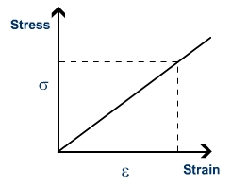
Material Nonlinearity
Global
Local
Local
Global
Force
Linear
Stress
Linear
Strain
Linear
Displacement
Equilibrium
equation
Constitutive
model
Compatibility
equation
σ
ε
Notes:
Geometric
Material
Force
Kinematic

Slide 4

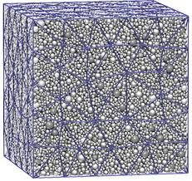
Material Nonlinearity

Slide 5
Equations
Weak form
Discretized system
Discretization
?

Slide 6
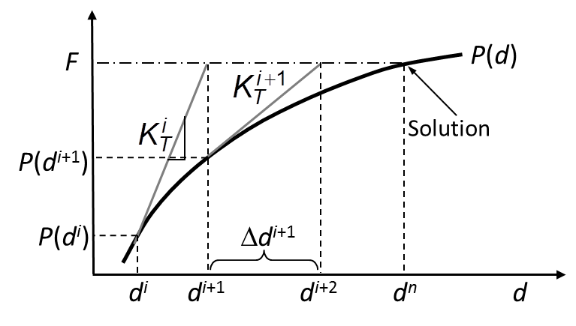
Equations
Newton-Raphson Iteration Method
Notes:
d: nodal displacement

Slide 7
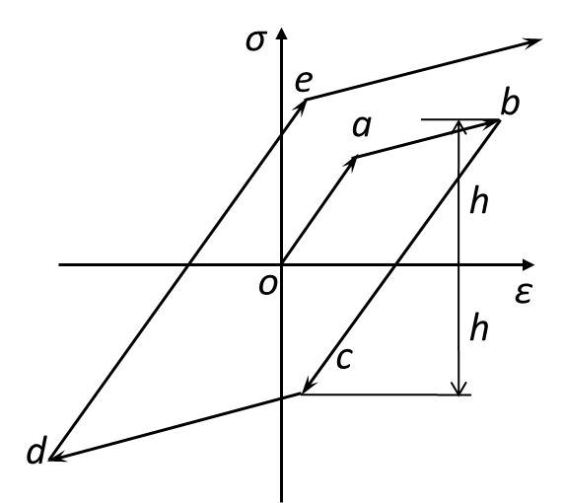
Application (Elastoplastic model)
Isotropic hardening model
Elastic range(yield stress) increases proportionally to plastic strain.
Material parameters:
1D
3D

Slide 8
Application (Elastoplastic model)
x₃
11kN
11kN
9
11kN
λ | μ | σ⁰_{Y} | H
110.7 GPa | 80.2 GPa | 400 MPa | 100 MPa
11kN
12
10
11
5
F_{i} = 0~4kN~8kN~10kN~11kN
8
6
7
1
4
x₂
2
x₁
3
Notes:
Mpa: mega
Gpa: giga

Slide 9
Application (Elastoplastic model)
F_{i} = 0~4kN~8kN~10kN~11kN
For each load step(N-R):
Elastic predictor
Plastic corrector
Notes:
Elastic predictor
Return mapping algorithm
Bisection, isoparametric mapping

Slide 10
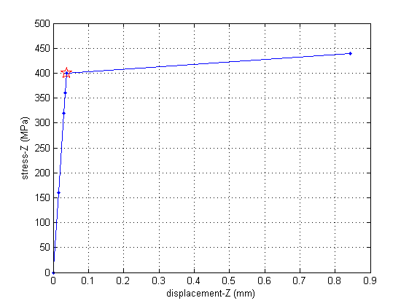
Application (Elastoplastic model)
x₃
11kN
11kN
9
11kN
11kN
12
10
11
5
8
6
7
1
4
x₂
2
x₁
3
Z direction stress-displacement curve (Node 12)

Slide 11
Thank you!

